Slide 1
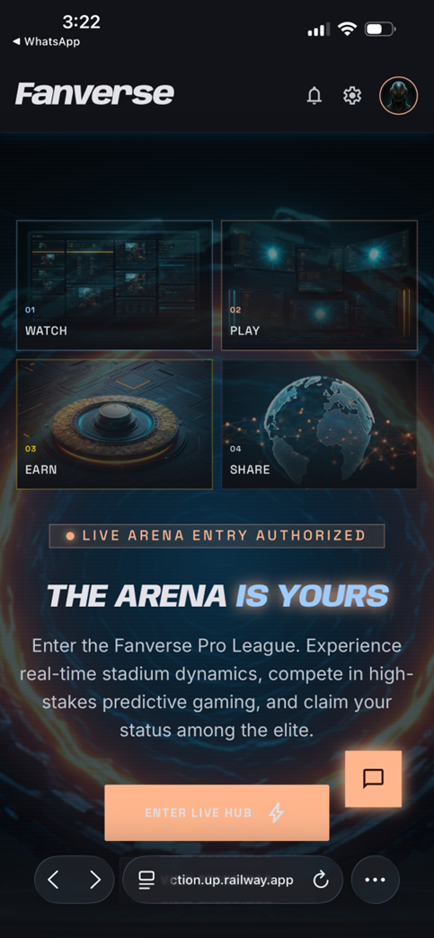
Very Dark background and the 4 Hub buttons are not visible properly
Human Inputs
Profile buttons/Settings need to be linked, currently not clickable
Button or box borders can also be in neon orange, maybe Watch-Play can also be in matching shades with the border lines to gain prominence
Text needs to be crisper--easier
Very Light colours and CTA is not visible properly

Slide 2
Agentic AI Inputs
Top Bar — Profile / Settings / Notifications (Bug: Not Clickable)
Observed on live build: The bell, gear, and avatar icons render correctly in the top-right, but they appear to be decorative — no route, no modal, no hover affordance.
Recommendations
Wire each icon to its intended route:
🔔 Bell → /notifications (with unread badge count)
⚙️ Gear → /settings
🧑 Avatar → /profile (or open a dropdown: Profile, Wallet, Logout)
Add a cursor: pointer, focus ring, and a subtle hover glow (neon-orange #FF6A1A at 30% opacity) so users get immediate visual feedback.
For accessibility, add aria-label ("Notifications", "Settings", "Profile") and a minimum 44×44px tap target.

Slide 3
Agentic AI Inputs
Hub Grid — Watch / Play / Earn / Share (Visibility Issue)
Observed on live build: Confirmed. Against the near-black background, the four tiles read as faint rectangles. The internal artwork is barely perceptible, and the labels 01 WATCH / 02 PLAY / 03 EARN / 04 SHARE sit at low contrast.
Root cause: Tile background ≈ #0B1118, border ≈ #1C2430, label text ≈ #6C7480 — all three sit within a 15-point luminance range, which fails WCAG AA contrast.
Recommendations
Raise tile elevation with a layered fill: base #10171F + an inner radial accent (rgba(255,106,26,0.08)) so the artwork pops.
Promote borders to neon orange as you suggested:
Default border: 1px solid rgba(255,106,26,0.55)
Hover/active: 2px solid #FF6A1A with an outer box-shadow: 0 0 18px rgba(255,106,26,0.55)
Differentiate Watch & Play (the two primary actions) with a slightly stronger orange wash on the background — e.g. a 6–8% orange overlay — while Earn & Share keep cooler cyan accents. This creates an obvious primary/secondary visual hierarchy.
Label contrast: lift label color to #F2F4F7 and the numeric prefix (01, 02…) to neon orange #FF6A1A for scan-ability.

Slide 4
Agentic AI Inputs
Hub Grid — Watch / Play / Earn / Share (Visibility Issue)
Observed on live build: Confirmed. Against the near-black background, the four
Token | Use | Hex
--accent-primary | Watch/Play tiles, CTA, key borders | #FF6A1A
--accent-glow | Outer glow on hover/active | rgba(255,106,26,0.55)
--accent-secondary | Earn/Share, links, badges | #3DD6FF
--surface-1 | Card base | #10171F
--surface-2 | Page background | #070A0F
--text-high | Headings | #FFFFFF
--text-mid | Body | #D5DBE3
Applying this token set across hub tiles, the "LIVE ARENA ENTRY GATE" pill, and the CTA will make the orange feel intentional rather than incidental.

Slide 5
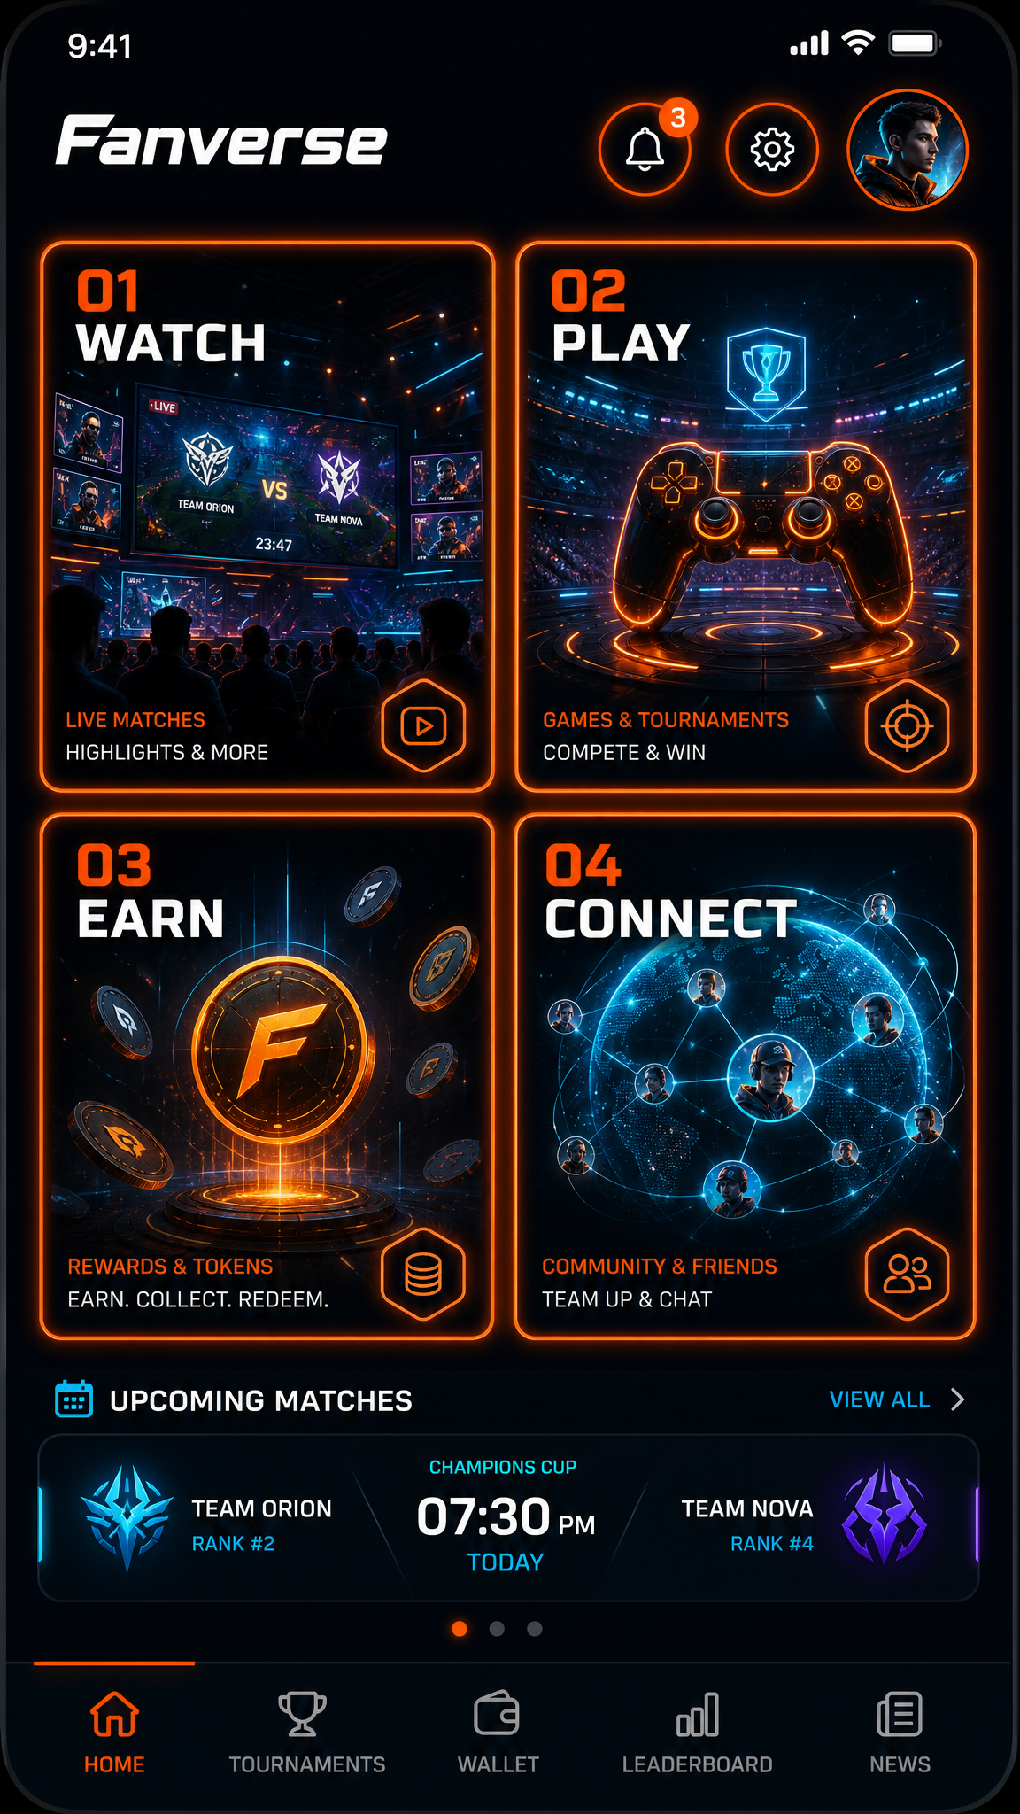
Key changes visualized in this mockup
Top bar icons now carry subtle orange glow rings → clearly clickable, with a notification badge on the bell.
Watch & Play tiles use bright neon-orange borders with outer glow → instantly become the primary CTAs.
Earn & Share tiles use cyan borders → clear secondary hierarchy.
"IS YOURS" recoloured to the orange gradient so the headline anchors to the brand accent (no more competing blue).
Body copy tightened to a 14-word single-line-feel paragraph.
"ENTER LIVE HUB" CTA: solid orange gradient #FF6A1A → #FF8A3D with pure white text and outer glow.
Floating chat bubble: dark fill + orange outline (no longer competes with the CTA).

Slide 6
Developer-Ready Design Spec
2.1 Color Tokens
Token | Hex | Usage
--accent-primary | #FF6A1A | Primary CTA, Watch/Play borders, active states, focus rings
--accent-primary-hover | #FF8A3D | Hover gradient stop
--accent-primary-pressed | #E0571A | Pressed/active state
--accent-glow | rgba(255,106,26,0.55) | Outer glow box-shadow
--accent-secondary | #3DD6FF | Earn/Share borders, info chips, links
--accent-warning | #F5C518 | Gold badge, "XP Multiplier" highlights
--surface-0 | #070A0F | Page background
--surface-1 | #10171F | Cards, hub tiles, input fields
--surface-2 | #1A2330 | Elevated cards (System Analytics)
--stroke-subtle | #1F2937 | Dividers, low-emphasis borders
--text-high | #FFFFFF | H1, H2, button labels
--text-mid | #E2E7EE | Body copy
--text-low | #94A0AE | Captions, helper text
--success | #22C55E | "OTP has been sent"
--danger | #EF4444 | Error states

Slide 7
Developer-Ready Design Spec
2.2 Typography Ramp
Style | Family | Size / Line | Weight | Letter-spacing
Display (THE ARENA IS YOURS) | Inter / Eurostile, italic | 32 / 38 | 800 | -0.5px
H2 (PREMIUM PARTNERS, VERIFY TOKEN) | Inter, italic | 24 / 30 | 700 | 0
H3 (Tile labels WATCH/PLAY) | Inter | 16 / 22 | 700 | +1px, uppercase
Tile numeral (01, 02…) | JetBrains Mono | 12 / 16 | 600 | +1.5px
Body | Inter | 15 / 24 | 500 | +0.2px
Caption | Inter | 12 / 18 | 500 | +0.6px, uppercase
Button | Inter | 15 / 20 | 700 | +1.2px, uppercase
OTP digit | JetBrains Mono | 28 / 32 | 700 | 0

Slide 8
Developer-Ready Design Spec
2.3 Spacing Scale (8-pt grid)
4 · 8 · 12 · 16 · 20 · 24 · 32 · 40 · 56 · 80
Screen edge padding: 16px (mobile), 24px (≥768px)
Tile grid gap: 12px
Section vertical rhythm: 40px between major blocks
Form field vertical gap: 20px
2.4 Radii & Elevation
Token | Value
--radius-sm | 6px (inputs, OTP cells)
--radius-md | 12px (tiles, cards)
--radius-lg | 16px (modals)
--radius-pill | 999px (status chips, CTAs)
--shadow-card | 0 4px 16px rgba(0,0,0,0.4)
--shadow-cta | 0 0 24px rgba(255,106,26,0.6)
--shadow-cta-hover | 0 0 32px rgba(255,106,26,0.75)

Slide 9
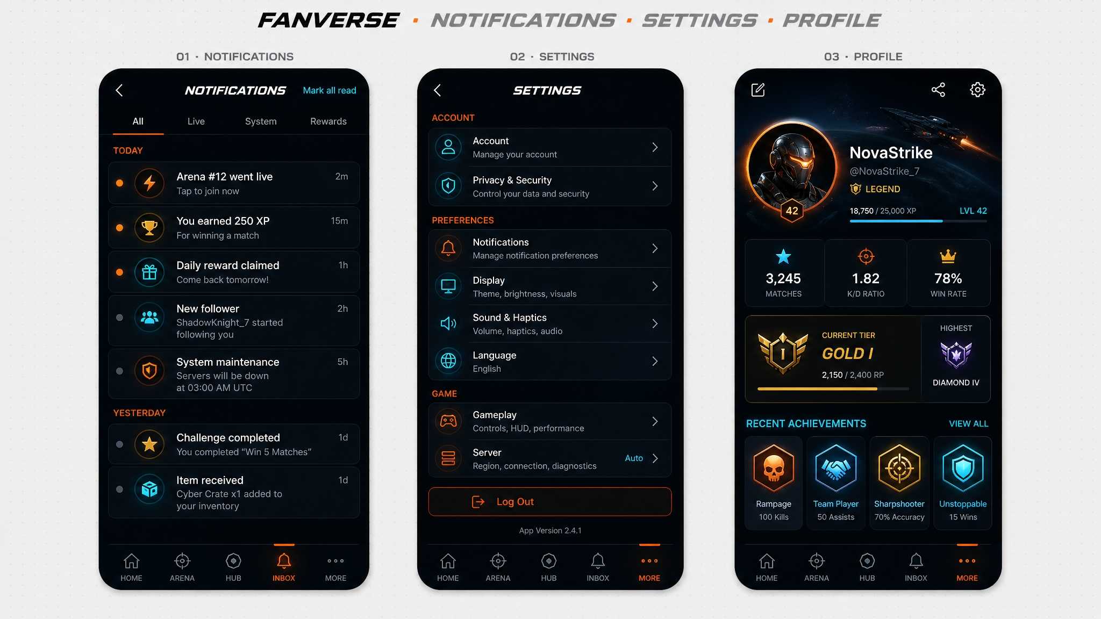

Slide 10
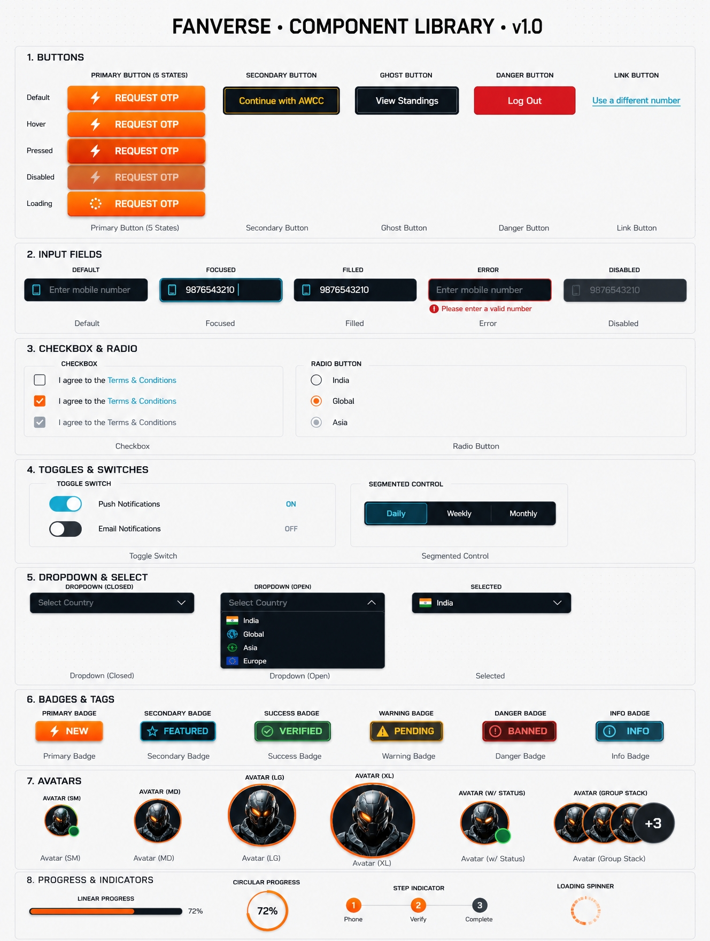

Slide 13
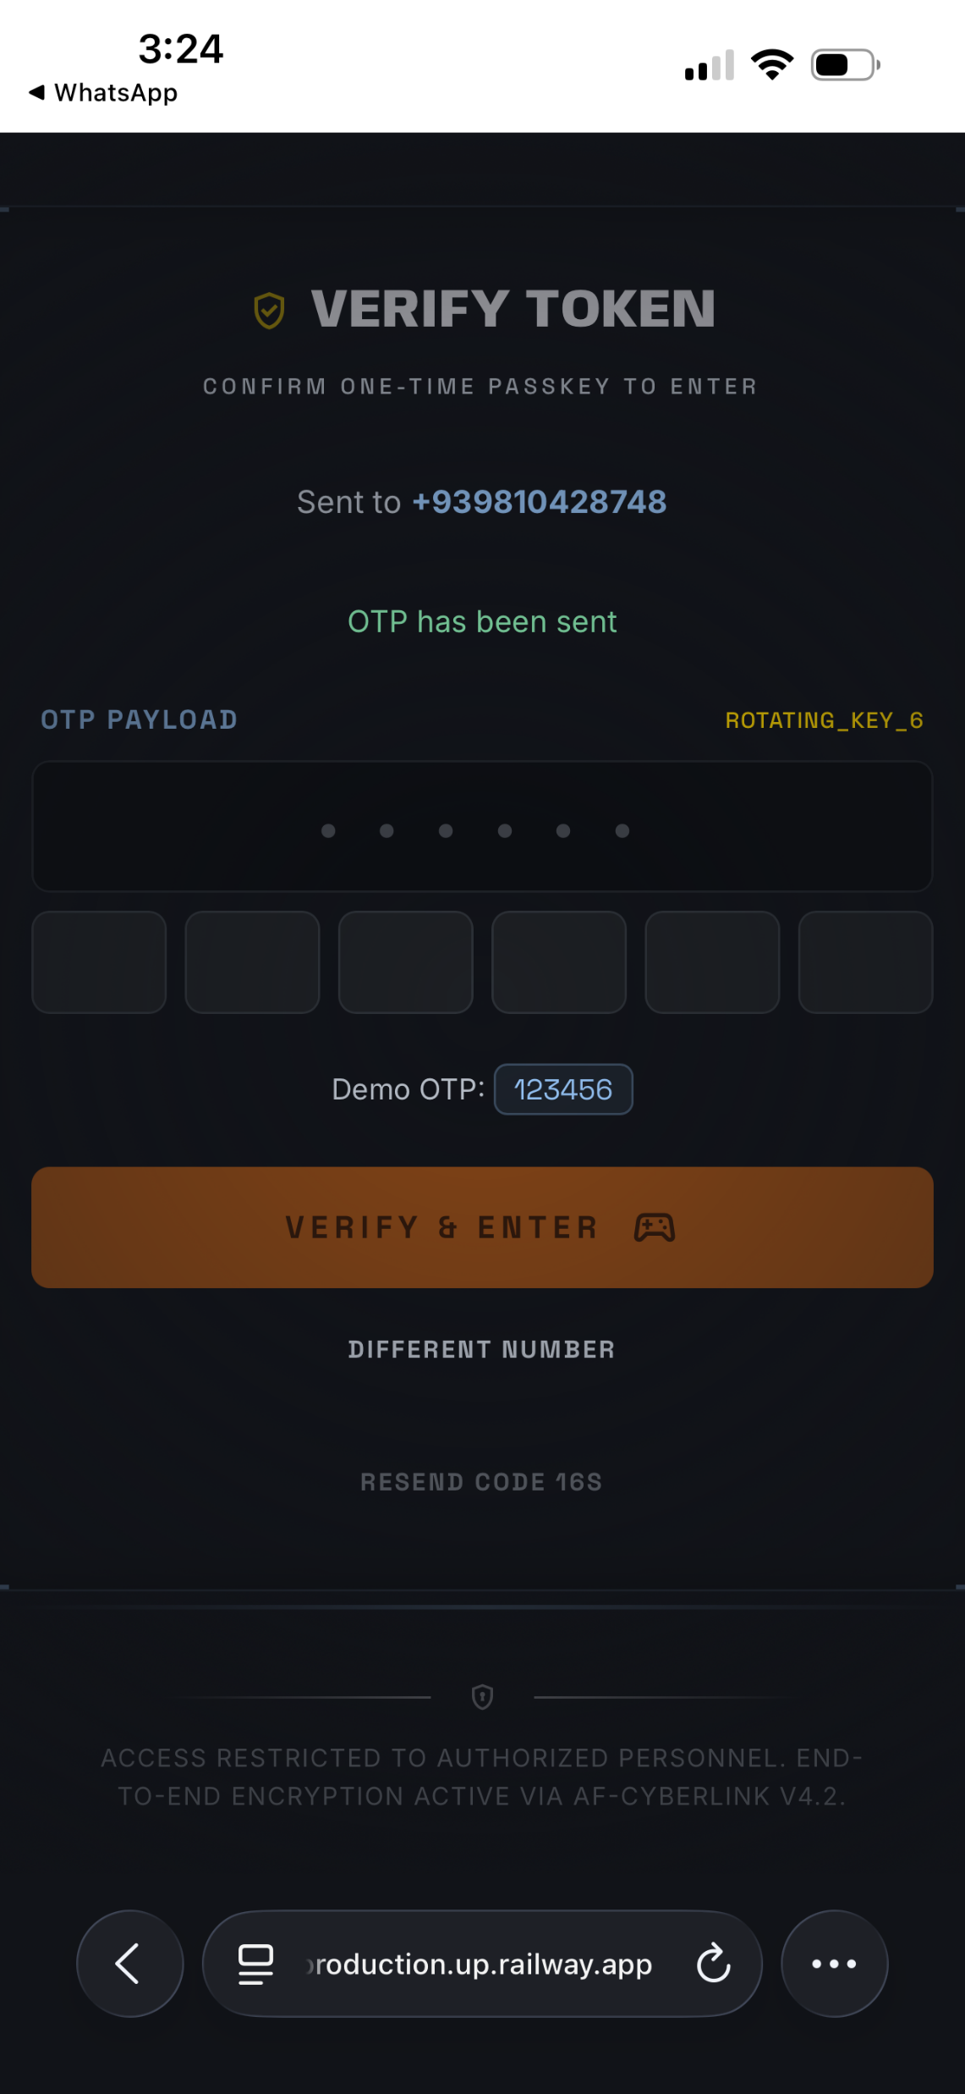
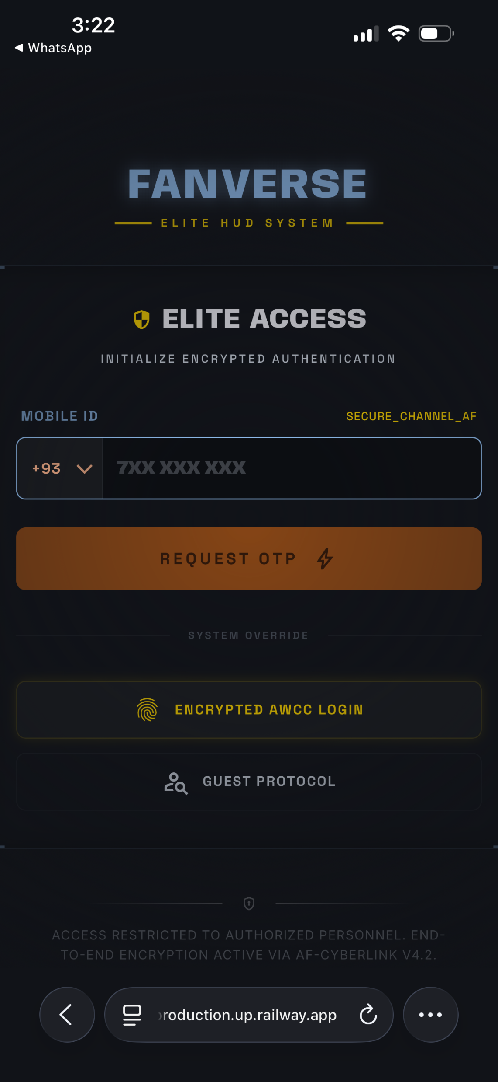
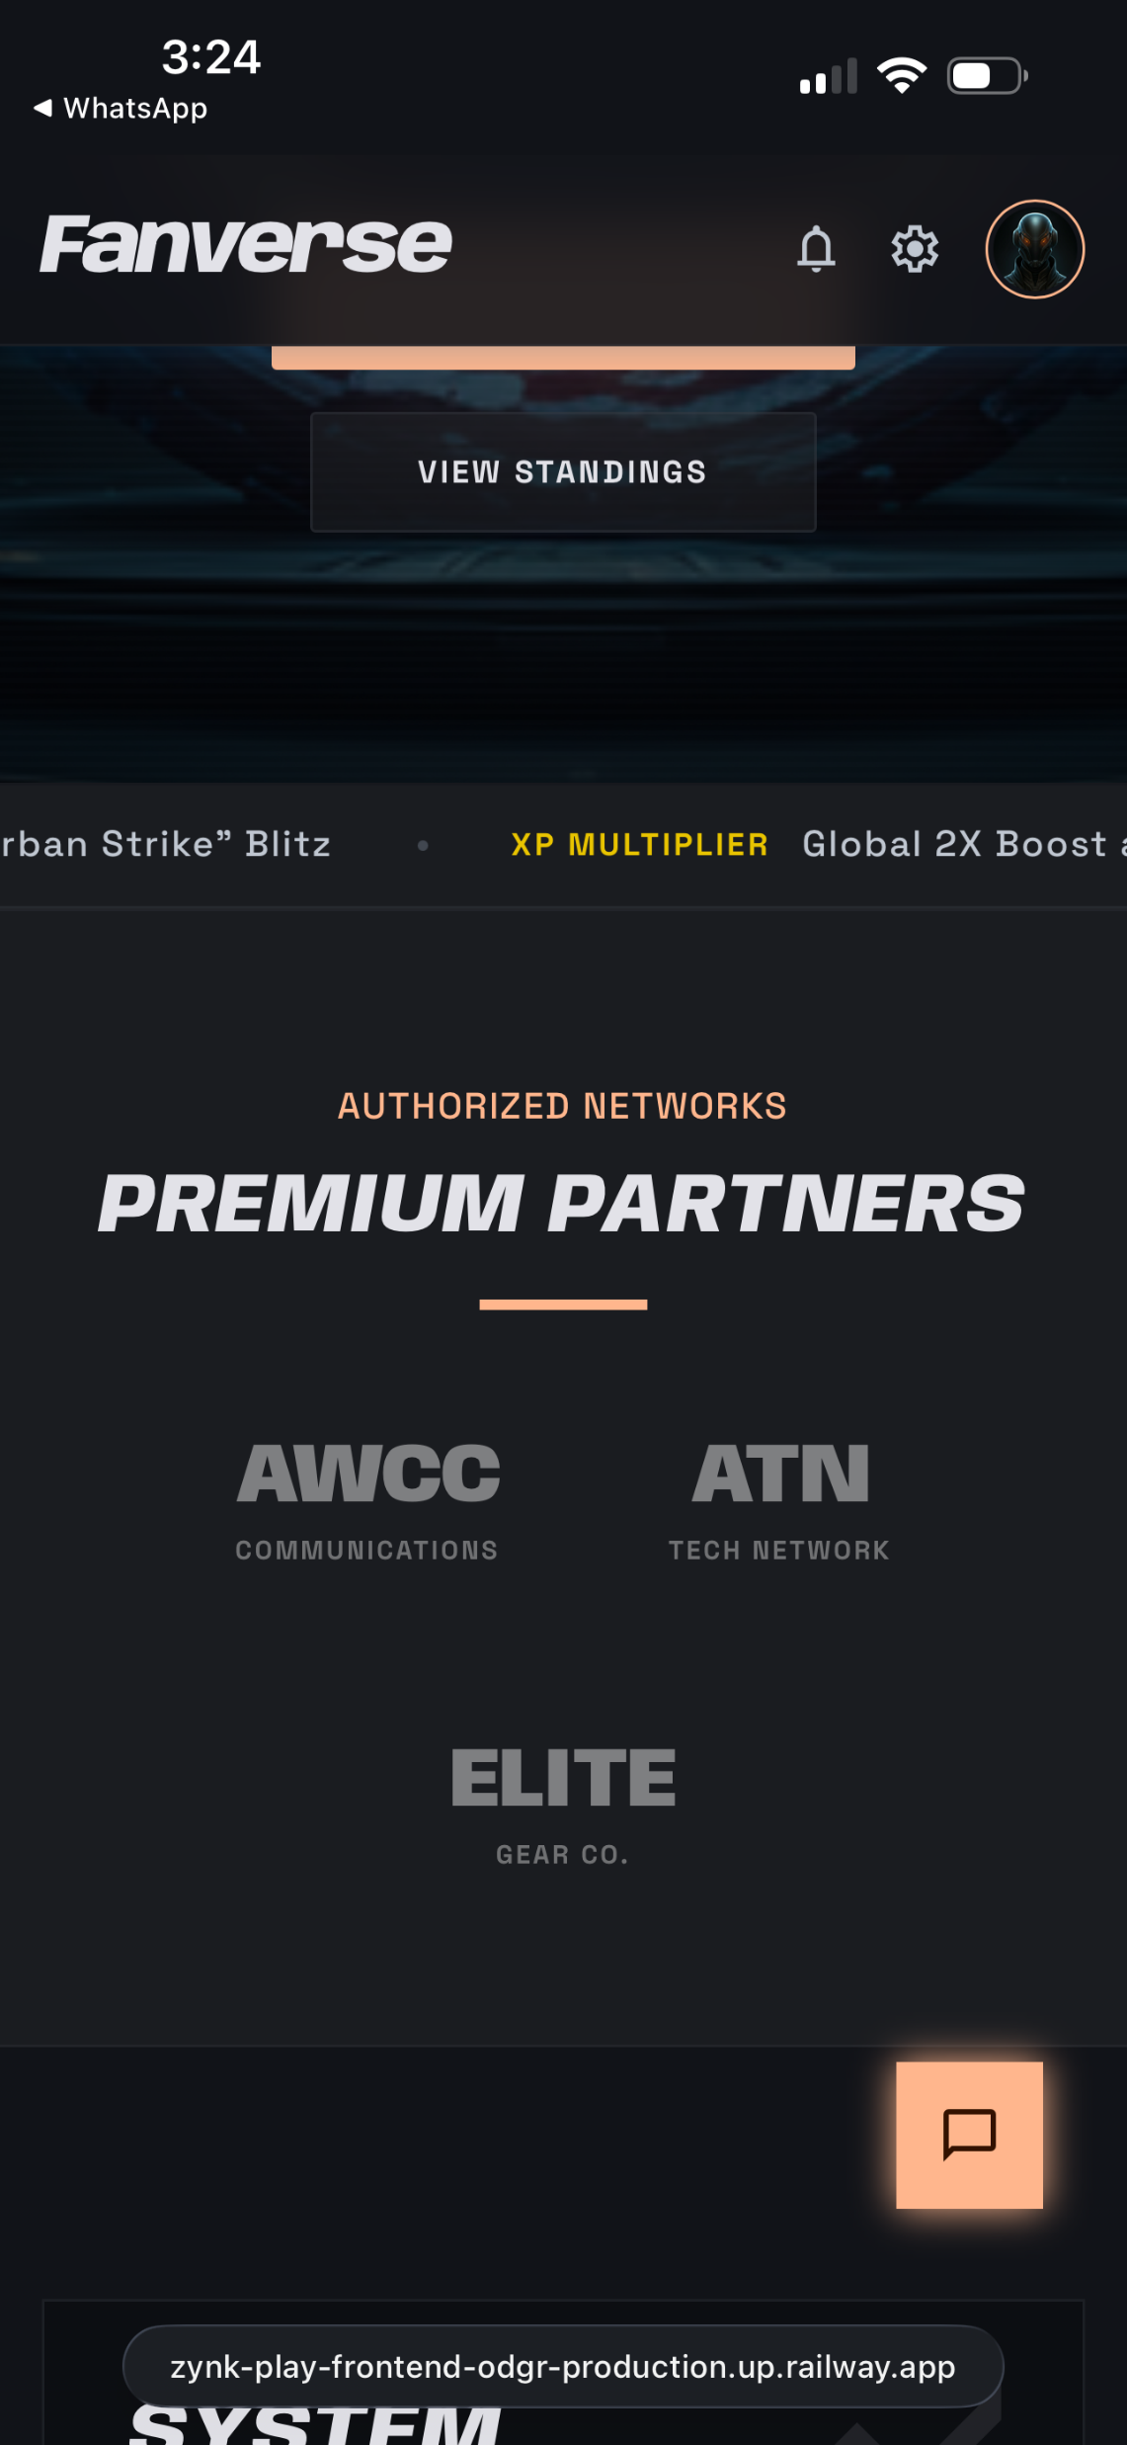


Slide 14


